Slide 1
Final presentation
Group 2
L. Hamacek, A. Hussain, C. Höglund, J. Larsson, S. Lindgren & A. Reddy

Slide 2
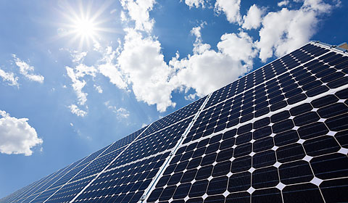
The client - RECAP
Bengt Stridh:
researcher at the Future Energy Center research specialization at MDH
developed detailed models in a previous project to analyze investment decisions for photovoltaic (PV) plants in Sweden, together with his colleagues
the current calculator based on these models is inside an Excel file, which uses built in functions to calculate the results

Slide 3
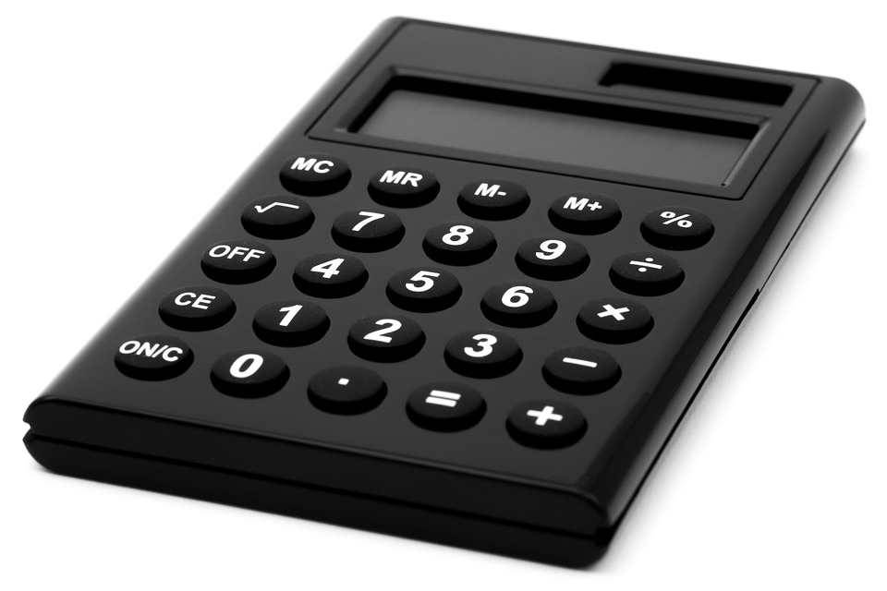
Our task - RECAP
Develop a web-based calculator that helps the users to determine what investments in solar energy that are suitable for them
The potential users are private persons and others (e.g. companies, property owners and cities)

Slide 4
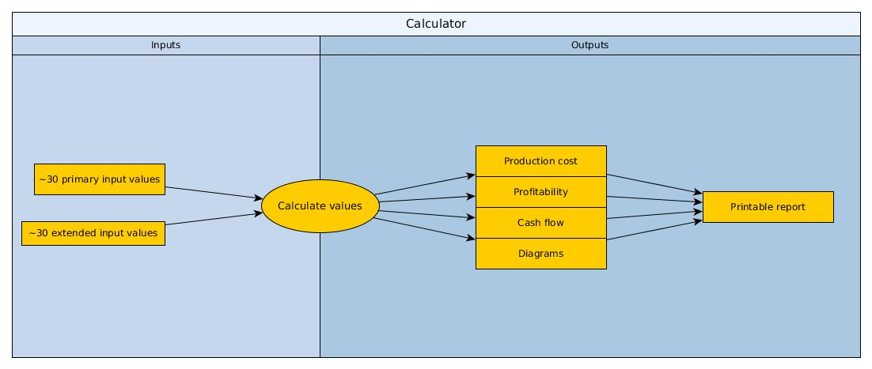
The system (web-based calculator) - RECAP

Slide 5
The client’s requirements - FULFILLED
Requirements that were a MUST:
Possibility to choose between private person and others
Provide guiding texts and recommended min and max for input values
Calculate the production cost, profitability and cash flow
Provide diagrams that show some of the calculated results
A printable PDF file containing both input and output values
Possibility to upload an Excel file for updating the default input values, guiding texts...

Slide 6
The client’s requirements - NOT FULFILLED
Requirements that were NOT A MUST:
Compare the calculated results for two sets of input values
Save used input values from one session to a session at a later time
Switch between English and Swedish language

Slide 7
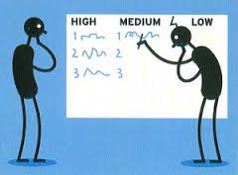
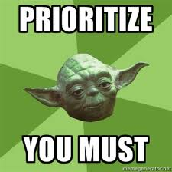
Prioritization of the requirements
Our way of prioritizing:
Focus on finishing the requirements that are MUST first, and make them as good as possible.
Then only if there is time left, make the requirements that are NOT A MUST.

Slide 8
Some reasons to why we did not finish all of the requirements
The provided Excel files by the client was in Swedish, and therefore it took more time for the English group members to understand them
The calculations of the cash flow tables was vast and time consuming
Took quite some time to for example test all of the columns’ calculations in the cash flow tables

Slide 9
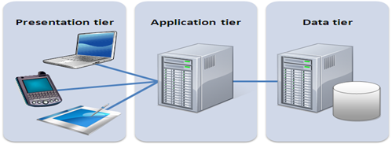
Three-tier architecture
Pros of using the three-tier architecture:
More secure
Easily scalable
Easily maintained

Slide 10

Design decisions
The three-tier architecture is commonly used for web-applications (i.e. well tested in real life)
We chose to use a database because the client wanted the following requirements:
Update default values, guiding texts etc. by uploading an Excel file (admin only)
Compare two results
Save previously used input values
Switch between English and Swedish language

Slide 11
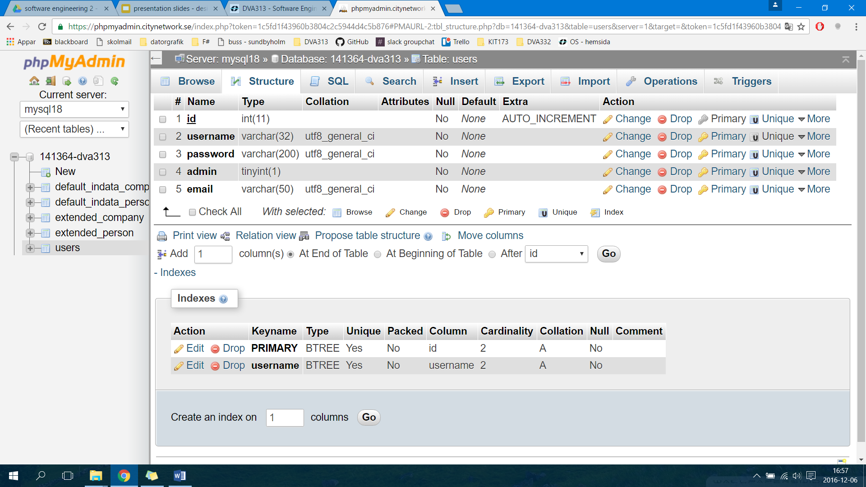
Database table - Login
OBS. Right now it only stores the Administrator’s login data

Slide 12
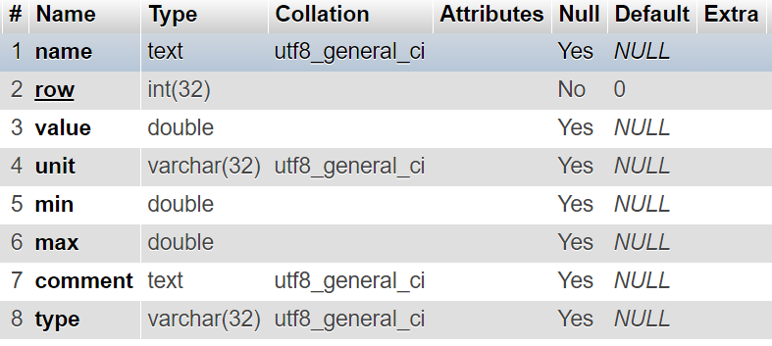
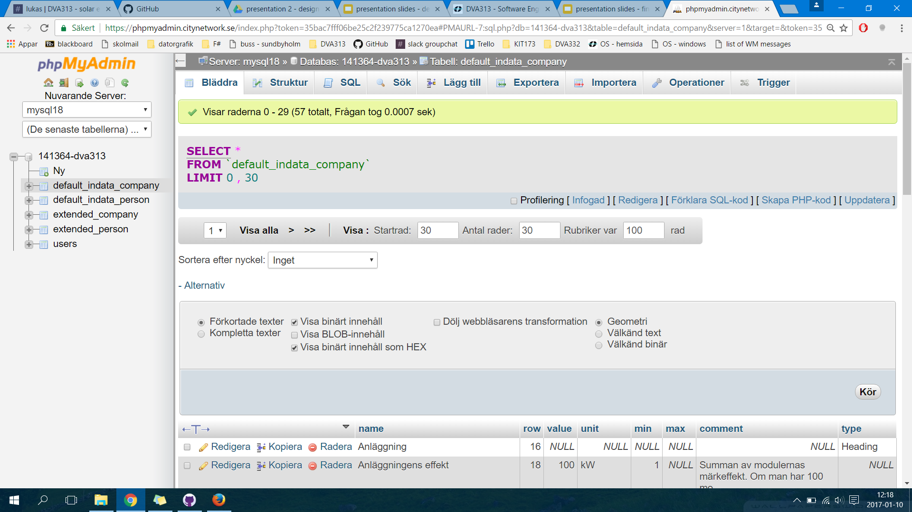
Database table - Default parameters
OBS. Four of these tables:

Slide 13
How the program is structured / How we use the available technologies
File Structure
One php/html file for layout
One javascript file for calculations and sending HTTP-requests
Some PHP-files for communicating with the database
During development one javascript file for each person
Technologies used
HTML, CSS, Bootstrap for layout and design
Jquery for doing the calculations
Angular for sending HTTP-requests and dynamically add content
PHP for communicating with the MySQL database
Libraries used are pdfmake, PHPExcel, Google Charts and more

Slide 14

How we have tried to ensure important qualities
User-friendliness:
Instructions on how to use the calculator and a dictionary
Default input values, guiding texts, recommended min and max values
“Accordions” to avoid a lot of scrolling
Formatting input values (e.g. 1000000 => 1 000 000)
Everything is available on one page
Calculating whenever the user changes any value, to avoid buttons
Security:
Admin login is hidden and uses secure techniques
Excel file uses validation for each cell
OBS. We also did user tests

Slide 15

Live demo

Slide 16

Initial plan and changes
Initial plan:
Try to implement all of the requirements (i.e. both the MUST and NOT MUST)
Changes:
Implement the MUST requirements as good as possible (i.e. better to have website that does all of them in a good way, compared to just some of them)

Slide 17

Activities and worked hours
Activity | Approximate worked hours (for all of the group members together)
External meetings with the steering group | 15
Client meetings and contact | 25
Internal meetings within the project group | 170
Presentation preparation (project plan and requirements) | 10
Presentation preparation (design and implementation) | 16
Presentation preparation (final) | 20
~27%
~6%

Slide 18
Presentation (project plan and requirements) | 16,5
Presentation (design and implementation) | 16,5
Presentation (final) | 16,5
Project plan | 32
Design description (1st version) | 25
Product (1st version) | [40 – included in other activities]
Design description (final version) | 22 [still working on it]
Product (final version) | [200 – included in other activities] [will probably be some minor updates]
Final project report | 30 [still working on it]
~6,5%
~14%

Slide 19
Review (project plan) | 3
Review (1st design description) | 4
Review/User test (1st product) | 3,5
Review (final design description) | 4 [still working on it]
Review/User test (final product) | 10 [will probably be more tests if updates are made]
Review (final project report) | 6 [still working on it]
~4%

Slide 20
Create a basic layout for the website | 12
Improved layout | 30
Create a login | 7
Update the default input values etc. through an Excel file | 8
Calculate production cost | 15
Calculate profitability | 20
Calculate cash flow | 30
Make diagrams show the results | 12
Create a downloadable PDF file | 20
Email function | 4
Database & Server | 20
Integration of units | 20
Testing | 35
~30%

Slide 21

Others (e.g. create accounts for Trello and GitHub, learn how to use Trello, GitHub and different web technologies, understand the given Excel files) | 90
Total worked hours (so far): | 768
~11%

Slide 22

Division and synchronization of the work
The division and synchronization was done through internal meetings and then later on visualized on the Trello board.
Everyone wrote on the documentations and presentations, but there usually was ~2 people who focused on most of the writing.
Everyone wrote code, and the implemented requirements were divided among the group members [table on the next slide].

Slide 23
Create a basic layout for the website | Lukas & Aliya
Improved layout | Jonathan, Lukas & Charlie
Create a login | Lukas
Update the default input values etc. through an Excel file | Jonathan
Calculate production cost | Charlie
Calculate profitability | Jonathan & Aliya
Calculate cash flow | Everyone
Make diagrams show the results | Charlie & Jonathan
Create a downloadable PDF file | Jonathan, Lukas & Charlie
Email function | Everyone
Database & Server | Jonathan
Integration of units | Jonathan
Testing | Everyone
How the implementation was divided

Slide 24

Changes in the organization and routines
Things that did not change:
Monday meetings with the external steering group (except for the non-mandatory one)
At least one internal meeting per week
Use the Trello board to follow the progress of activities
Use GitHub to store and share files (code, documentation, reported hours etc.)
...
Things that did change:
Sometimes some group members had to take on another role/responsibility (e.g. client contact, documentation and presentation, report overseer), for reasons such as someone was sick or unreachable

Slide 25

Experiences from the project
Positive things:
You can divide the tasks among several people
Being several people provides different experiences/ways of looking at things
Challenges:
You have to synchronize with each other (i.e. everyone has a different agenda)
You might have to wait for someone else to finish their task, so that you can continue with yours
Hard to know how much time something is going to take
Improvements for next time:
It will probably be easier to determine how much time some tasks are going to take

Slide 26

ANY QUESTIONS?

